Slide 1
Introduction

Slide 2
Objectives
To learn and appreciate the following concepts:
Introduction
Fundamentals of Algorithmic Problem Solving
Important Problem Types
Fundamentals Data Structures

Slide 3
Session outcome
At the end of session the student will be able to understand:
What is algorithm
Understanding problem
Importance of algorithmic problem solving, problem types
Fundamental Data Structures

Slide 4
All algorithms must satisfy the following criteria:
Input: Zero or more quantities are externally supplied.
Output: At least one quantity is produced.
Definiteness: Each instruction is clear and unambiguous.
Finiteness: algorithm terminates after a finite number of steps.
Effectiveness: Steps are sufficiently simple and basic

Slide 5

Algorithm
An algorithm is a step-by-step procedure for solving a problem in a finite amount of time.
Problem
Algorithm
Input
Computer
Output

Slide 6
What is algorithm?
An algorithm is a sequence of unambiguous instructions for solving a problem, i.e., for obtaining a required output for any legitimate input in a finite amount of time.
Problem
Algorithm
“Computer”
Input
Output

Slide 7
Example: GCD of two number
Can be solved in many methods for the same problem
Example help us illustrate several important points
Non-ambiguity
Range of inputs
The same algorithm can be represented in different ways
Several algorithms for solving the same problem
Different ideas can solve the same problem with dramatically different speed

Slide 8
Method 1: Euclid’s Algorithm
Problem: Find gcd(m,n), the greatest common divisor of two non-negative, not both zero integers m and n
Examples:
gcd(60,24) = 12, gcd(60,0) = 60, gcd(0,0) = ?
Euclid’s algorithm is based on repeated application of equality
gcd(m,n) = gcd(n, m mod n)
until the second number becomes 0, which makes the problem trivial.
Example:
gcd(60,24) = gcd(24,12) = gcd(12,0) = 12

Slide 9
Two descriptions of Euclid’s algorithm
Step 1: If n = 0, return m and stop;
otherwise go to Step 2
Step 2: Divide m by n and
assign the value for the remainder to r
Step 3: Assign the value of n to m and
the value of r to n. Go to Step 1.
while n ≠ 0 do
r ← m mod n
m← n
n ← r
return m

Slide 10
Other methods for computing gcd(m,n)
Consecutive integer checking algorithm:
Step 1: Assign the value of min{m,n} to ‘t’
Step 2: Divide ‘m’ by ‘t’.
If the remainder is 0, go to Step 3; otherwise, go to Step 4
Step 3: Divide ‘n’ by ‘t’.
If the remainder is 0, return ‘t’ and stop; otherwise, go to Step 4
Step 4: Decrease ‘t’ by 1 and go to Step 2

Slide 11
Middle-school procedure for computing gcd(m, n)
Step 1 Find the prime factors of m.
Step 2 Find the prime factors of n.
Step 3 Identify all the common factors in the two prime expansions found in Step 1 and Step 2. (If p is a common factor occurring p_{m} and p_{n} times in m and n, respectively, it should be repeated min{p_{m}, p_{n}} times.)
Step 4 Compute the product of all the common factors and return it as the greatest common divisor of the numbers given.

Slide 12
TRY
a. Find gcd(31415, 14142) by applying Euclid’s algorithm.
b. Estimate how many times faster it will be to find gcd(31415, 14142) by Euclid’s algorithm compared with the algorithm based on checking consecutive integers from min{m, n} down to gcd(m, n).

Slide 13
Some Well-known Computational Problems
Sorting
Searching
Shortest paths in a graph
Minimum spanning tree
Traveling salesman problem
Knapsack problem
Towers of Hanoi
Some of these problems don’t have efficient algorithms, or algorithms at all!

Slide 14
Fundamentals of Algorithmic Problem Solving
Algorithms are procedural solutions to problems.
Steps for designing and analyzing an algorithm:
Understand the problem: An input to an algorithm specifies an instance of the problem the algorithm solves. It is very important to specify exactly the set of instances the algorithm needs to handle. (As an example, recall the variations in the set of instances for the three greatest common divisor algorithms).
Ascertain the capabilities of a computational device: random-access machine (RAM). sequential algorithms, parallel algorithms.
Choose between exact and approximate problem solving: In the former case, an algorithm is called an exact algorithm; in the latter case, an algorithm is called an approximation algorithm
Algorithm Design Techniques: An algorithm design technique (or “strategy” or “paradigm”) is a general approach to solving problems algorithmically that is applicable to a variety of problems from different areas of computing.
Designing an algorithm and Data Structures: Algorithms + Data Structures = Programs

Slide 15
Fundamentals of Algorithmic Problem Solving
Understand the problem
Decide on computational means
Exact vs approximate solution
Data structures
Algorithm design technique
Design an algorithm
Prove correctness
Analyze the algorithm
Code the algorithm

Slide 16
Proving an Algorithm’s Correctness
What does it mean to understand the problem?
What are the problem objects?
What are the operations applied to the objects?
Deciding on computational means
How the objects would be represented?
How the operations would be implemented?
Design an algorithm
Build a computational model of the solving process
Prove correctness
Correct output for every legitimate input in finite time
Based on correct math formula
By induction

Slide 17
Fundamentals of Algorithmic Problem Solving
Analyze the algorithm
Efficiency: time and space
Simplicity
Generality: range of inputs, special cases
Optimality: no other algorithm can do better
Coding an Algorithm
How the objects and operations in the algorithm are represented in the chosen programming language?

Slide 18
Real-World Applications
Hardware design: VLSI chips
Compilers
Computer graphics: movies, video games
Routing messages in the Internet
Searching the Web
Distributed file sharing
Computer aided design and manufacturing
Security: e-commerce, voting machines
Multimedia: CD player, DVD, MP3, JPG, HDTV
DNA sequencing, protein folding and many more!

Slide 19
Some Important Problem Types
Sorting
a set of items
Searching
among a set of items
String processing
text, bit strings, gene sequences
Graphs
model objects and their relationships
Combinatorial
find desired permutation, combination or subset
Geometric
graphics, imaging, robotics
Numerical
continuous math: solving equations, evaluating functions

Slide 20
Algorithm design strategies/Techniques
Brute Force & Exhaustive Search
follow definition / try all possibilities
Divide & Conquer
break problem into distinct subproblems
Transformation
convert problem to another one
Dynamic Programming
break problem into overlapping subproblems
Greedy
repeatedly do what is best now
Iterative Improvement
repeatedly improve current solution
Randomization
use random numbers

Slide 21
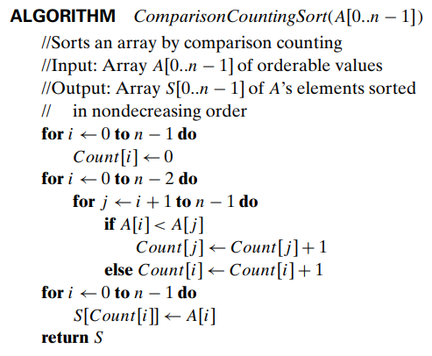
Try
Consider the algorithm for the sorting problem that sorts an array by counting, for each of its elements, the number of smaller elements and then uses this information to put the element in its appropriate position in the sorted array:
Apply this algorithm to sorting the list 60, 35, 81, 98, 14, 47.
Is this algorithm stable?
Is it in-place

Slide 22
Fundamental data structures
Linear data structures
Array
Linked list
Stack
Queue
Operations: Search, Delete, Insert.
Implementation: Static, Dynamic.

Slide 23
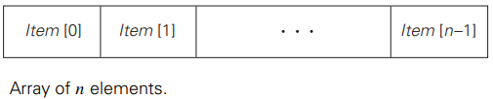
Fundamental data structures
The two most important elementary data structures are the array and the linked list.
A (one-dimensional) array is a sequence of n items of the same data type that are stored contiguously in computer memory and made accessible by specifying a value of the array’s index.
Arrays are used for implementing a variety of other data structures. Prominent among them is the string, a sequence of characters from an alphabet terminated by a special character indicating the string’s end. Strings composed of zeros and ones are called binary strings or bit strings.

Slide 24



Fundamental data structures
A linked list is a sequence of zero or more elements called nodes, each containing two kinds of information: some data and one or more links called pointers to other nodes of the linked list.
(A special pointer called “null” is used to indicate the absence of a node’s successor.) In a singly linked list, each node except the last one contains a single pointer to the next element.
Another extension is the structure called the doubly linked list, in which every node, except the first and the last, contains pointers to both its successor and its predecessor.

Slide 25
Stack and Queue
A list is a finite sequence of data items, i.e., a collection of data items arranged in a certain linear order.
Two special types of lists, stacks and queues, are particularly important. A stack is a list in which insertions and deletions can be done only at the end.
A queue, on the other hand, is a list from which elements are deleted from one end of the structure, called the front (this operation is called dequeue), and new elements are added to the other end, called the rear (this operation is called enqueue).
A priority queue is a collection of data items from a totally ordered universe (most often, integer or real numbers).

Slide 26
Non-linear data structures
Graphs
Trees : connected graph without cycles
Rooted trees
Ordered trees
Binary trees
Graph representation: adjacency lists,
adjacency matrix
Tree representation: graphs; binary nodes

Slide 27
Graphs
A graph G = (V,E) is defined by a pair of two sets: a finite nonempty set ‘V’ of items called vertices and a set ‘E’ of pairs of these items called edges.
If these pairs of vertices are unordered, i.e., a pair of vertices (u, v) is the same as the pair (v, u), we say that the vertices u and v are adjacent to each other and that they are connected by the undirected edge (u, v).
The vertices u and v endpoints of the edge (u, v) and say that u and v are incident to this edge; the edge (u, v) is incident to its endpoints u and v. A graph G is called undirected if every edge in it is undirected.

Slide 28
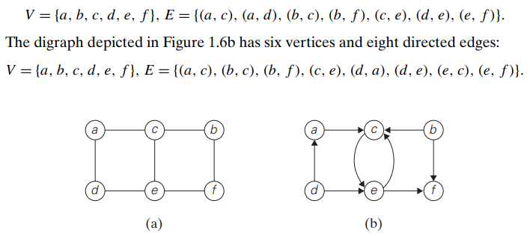
Graphs
If a pair of vertices (u, v) is not the same as the pair (v, u), we say that the edge (u, v) is directed from the vertex u, called the edge’s tail, to the vertex v, called the edge’s head. We also say that the edge (u, v) leaves u and enters v. A graph whose every edge is directed is called directed. Directed graphs are also called digraphs.
(a) Undirected graph. (b) Digraph.

Slide 29
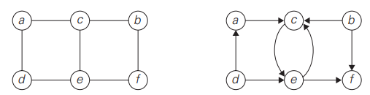
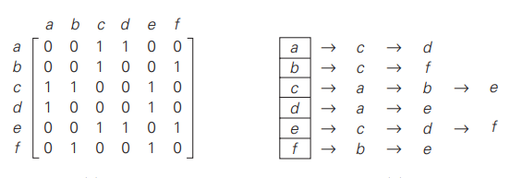
Adjacency matrix and Adjacency lists
(a) Undirected graph. (b) Digraph.
(a) Adjacency matrix and (b) adjacency lists of the graph

Slide 30
weighted graph and Path
A weighted graph (or weighted digraph) is a graph (or digraph) with numbers assigned to its edges. These numbers are called weights or costs.
If a weighted graph is represented by its adjacency matrix, then its element A[i, j ] will simply contain the weight of the edge from the ith to the jth vertex if there is such an edge and a special symbol, e.g., ∞, if there is no such edge. Such a matrix is called the weight matrix or cost matrix.
A path from vertex u to vertex v of a graph G can be defined as a sequence of adjacent (connected by an edge) vertices that starts with u and ends with v.

Slide 31
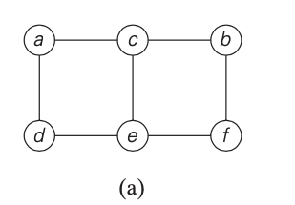
Path
If all vertices of a path are distinct, the path is said to be simple. The length of a path is the total number of vertices in the vertex sequence defining the path minus 1, which is the same as the number of edges in the path. For example, a, c, b, f is a simple path of length 3 from a to f in the graph, whereas a, c, e, c, b, f is a path (not simple) of length 5 from a to f.

Slide 32
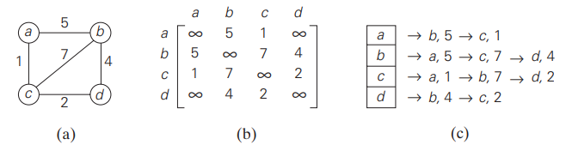
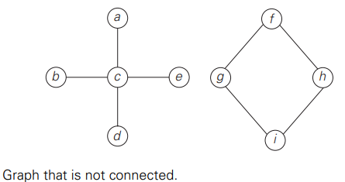
Graphs Example
(a) Weighted graph. (b) Its weight matrix. (c) Its adjacency lists

Slide 33
Directed path and Cycle
A directed path is a sequence of vertices in which every consecutive pair of the vertices is connected by an edge directed from the vertex listed first to the vertex listed next.
A graph is said to be connected if for every pair of its vertices u and v there is a path from u to v.
A connected component is a maximal (not expandable by including another vertex and an edge) connected subgraph of a given graph.
A cycle is a path of a positive length that starts and ends at the same vertex and does not traverse the same edge more than once.

Slide 34
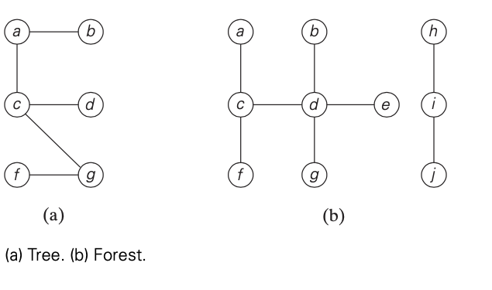
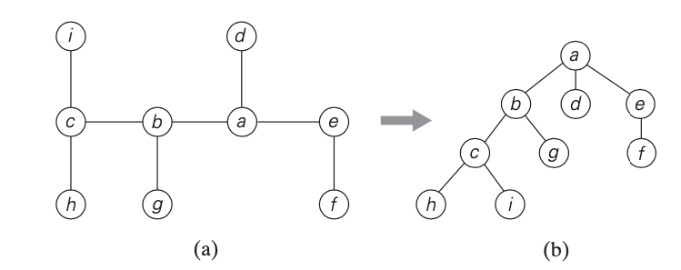
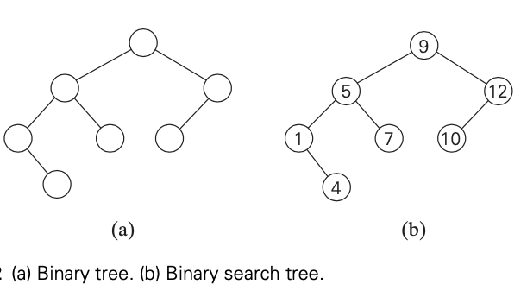
Trees
A tree (more accurately, a free tree) is a connected acyclic graph (Figure 1.10a). A graph that has no cycles but is not necessarily connected is called a forest.
A binary tree can be defined as an ordered tree in which every vertex has no more than two children and each child is designated as either a left child or a right child of its parent; a binary tree may also be empty.

Slide 35
Sets, Bags, Dictionaries
Set: unordered collection of distinct elements
Operations: membership, union, intersection
Representation: bit string; linear structure
Bag: unordered collection,
elements may be repeated
Dictionary: a bag with operations search, add, delete

Slide 36
Sets, Bags, Dictionaries
A set can be described as an unordered collection (possibly empty) of distinct items called elements of the set.
A specific set is defined either by an explicit listing of its elements (e.g., S = {2, 3, 5, 7}) or by specifying a property that all the set’s elements and only they must satisfy (e.g., S = {n: n is a prime number smaller than 10}).
A set cannot contain identical elements; a list can. This requirement for uniqueness is sometimes circumvented by the introduction of a multiset, or bag, an unordered collection of items that are not necessarily distinct.
The operations we need to perform for a set or a multiset most often are searching for a given item, adding a new item, and deleting an item from the collection. A data structure that implements these three operations is called the dictionary.

